Slide 1
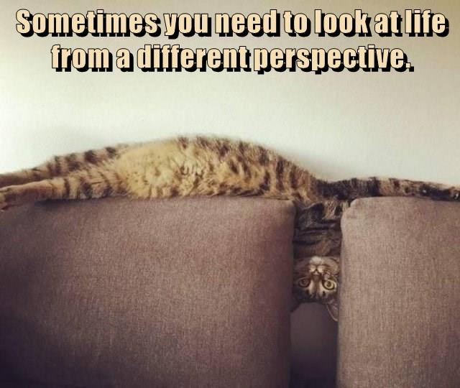
AOK’s and Perspective
https://i.chzbgr.com/full/9396463616/h4FB8C6B4/a-different-perspective

Slide 2

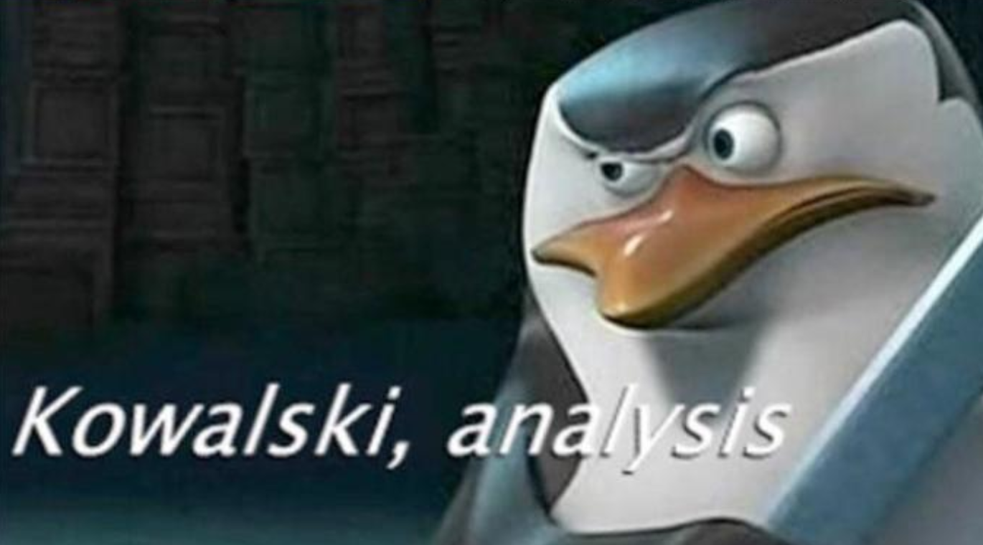
Knowledge framework
Scope
Perspective
Methods & Tools
Ethics
https://i.kym-cdn.com/editorials/icons/original/000/000/293/Screen_Shot_2018-10-25_at_2.28.46_PM.png

Slide 3
Perspective
This element focuses on the importance and influence of perspectives and context. This includes:
reflection on the students’ own perspectives and what informs them,
as well as how different people or groups view or approach knowledge in the different themes/areas of knowledge.
It also includes reflection on historical perspectives and how knowledge changes over time.

Slide 4
Knowledge Questions
What is the significance of key historical developments within these themes/areas of knowledge?
What do these themes/areas of knowledge identify about knowledge that is rooted in particular social and cultural groups?
Are some types of knowledge less open to interpretation than others?
Is an understanding of the perspective of other knowers essential in the pursuit of knowledge?

Slide 5
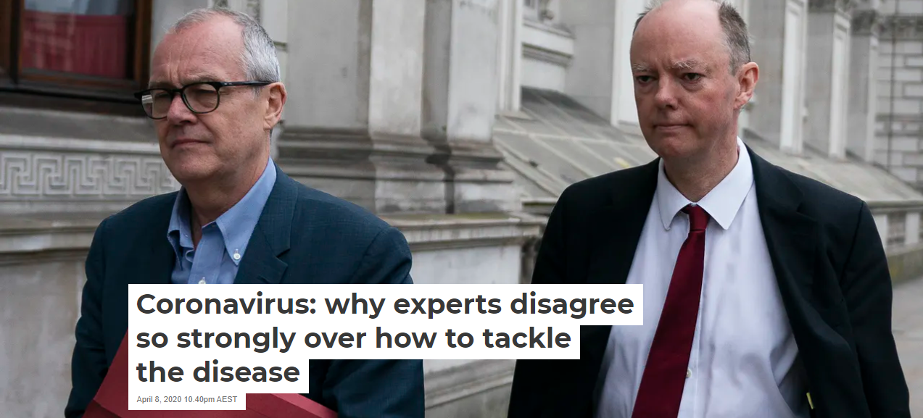
Notes:
Irfan

Slide 6
How can we decide between the judgments of experts if they disagree with each other?
Notes:
Irfan

Slide 7
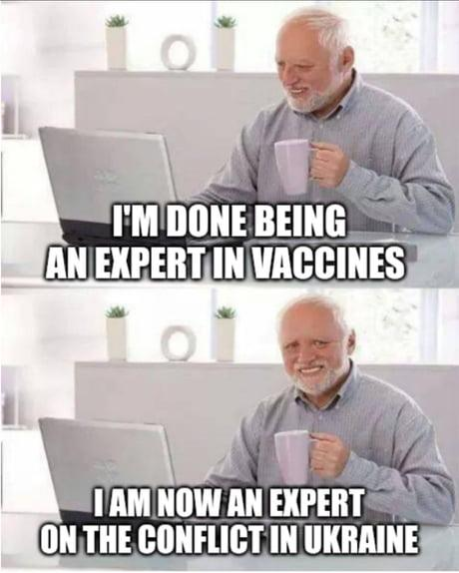
Role of Expert
Most of our knowledge of different subject comes from experts in the field who share their findings and discoveries.
What content you have in the textbook is a result of combination of experts.
Our perspective in general and in different subjects is shaped by what experts we choose to follow/read/listen
https://img-9gag-fun.9cache.com/photo/aVxbbLw_460s.jpg

Slide 8
Appeal to authority
When experts are divided, and we are not experts ourselves, whom do we trust?
Consider the positions and judgements of other experts and find out majority opinion
Julian Baggini - triage of truth
Are there any experts in this domain?
Which kind of expert in this area should I choose?
Which particular expert is worth listening to here?
What is the difference in these two situations?
A dentist telling you that you have a cavity
Economist forecasting economic growth

Slide 9
Is our choice of expert already biased?
How we think about expertise is influenced by the opinions of experts that we already trust.
Makes hard for you to accept new knowledge and new expertise
Jean-paul Sartre:
“If seek counsel - from a priest, for example - you have selected that priest; and at the bottom you already knew, more or less, what he would advise.”

Slide 10
Expert Opinion
Consider the way in which your knowledge has been influenced by what experts think and say.
Discuss with your peers:
How important have experts been for the knowledge you have gained?
Do you regularly refer to expert knowledge for the claims you make?
Recall a situation when you have encountered contradicting expert opinions. How did you decide whom to trust?

